Slide 1
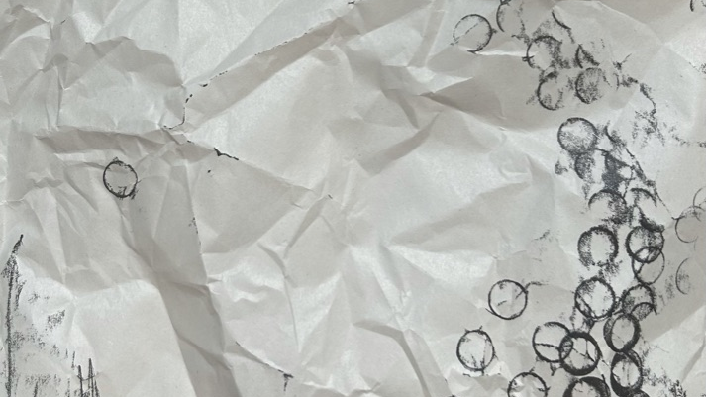
Final presentation
Viola

Slide 2
introduction
In this presentation I am going to present my five courses and the final work that I have completed based on the five courses of study.

Slide 3
main word- structure- space
The basis for all development

Slide 4
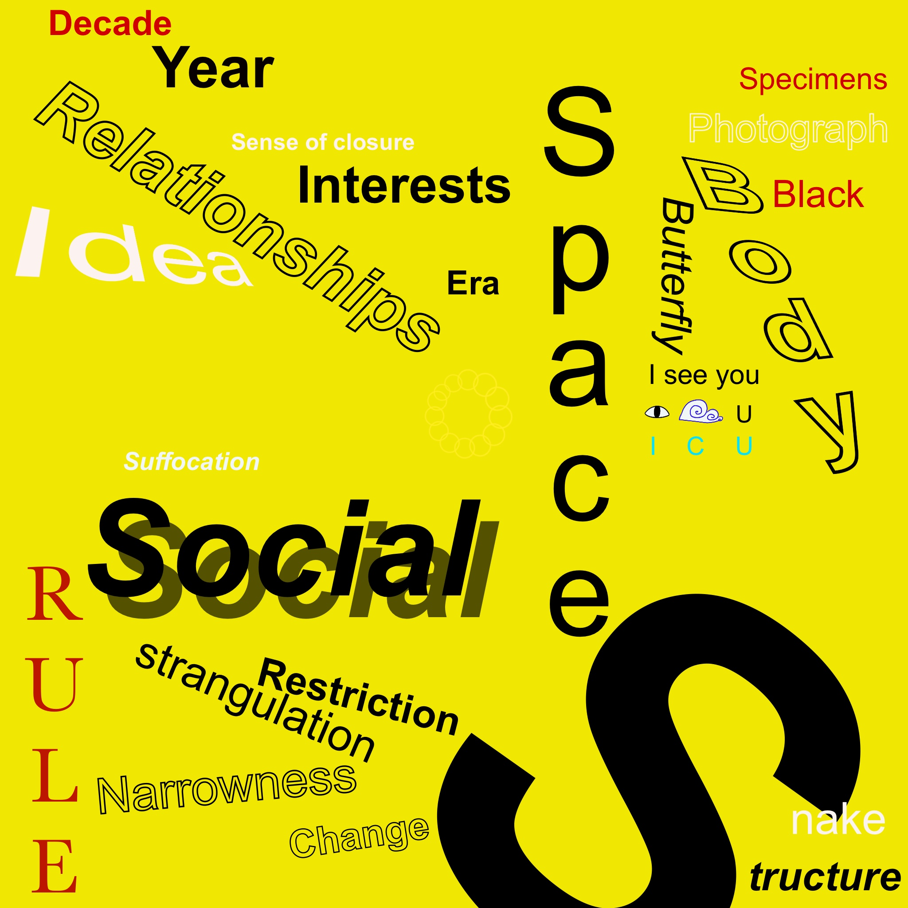
mind map
The initial development

Slide 5

Research
Primary research
Secondary research

Slide 6
research
Spiritual inspiration
Research in form
Material reference

Slide 7
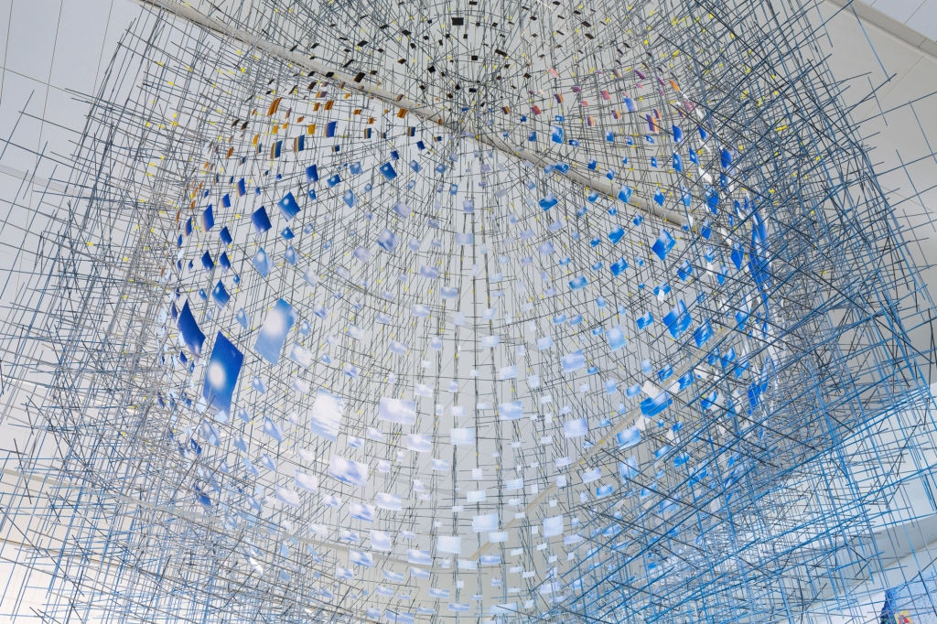
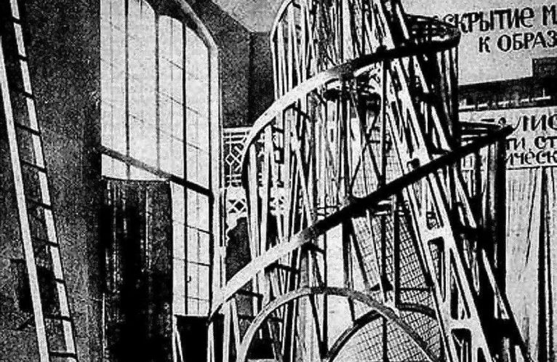
Spiritual inspiration
· Sarah Sze： The installation artist's work is also like her words, as she has always cleverly linked time and society with various materials in life.
· Constructivism： Structuralism differs from the various Classicalisms that were popular in the past in that they do not serve a designated person or class of people. Rather, they served the masses and sought to awaken the spirit of the people.

Slide 8
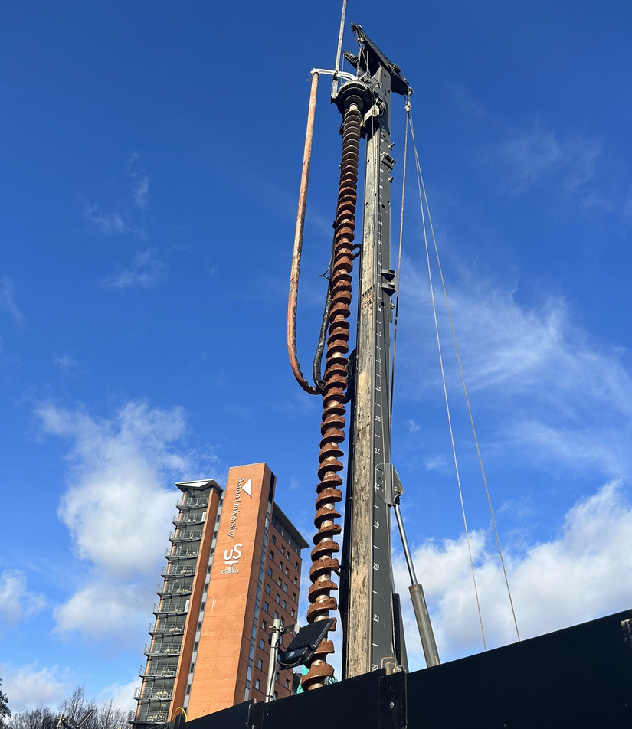
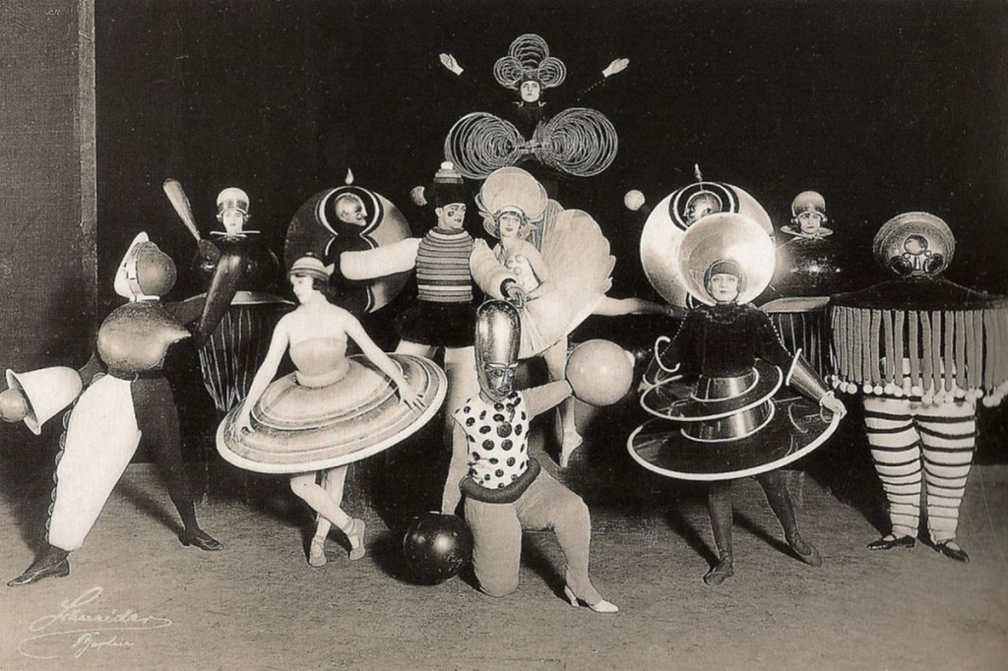
Research in form
Bauhaus: this is an obvious style, Usually, the style of Bauhaus is a mix of industry and design. Designers think the simple is complexity. They use art with craft and mass production.
Auger driller: It was a very tall spiral device, constantly spinning and destroying the original mechanism of the land. It was a very powerful and existential installation.

Slide 9
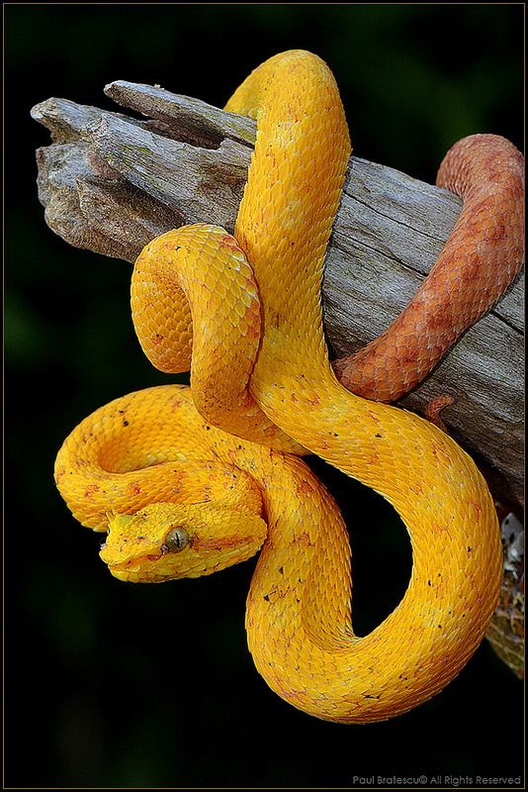
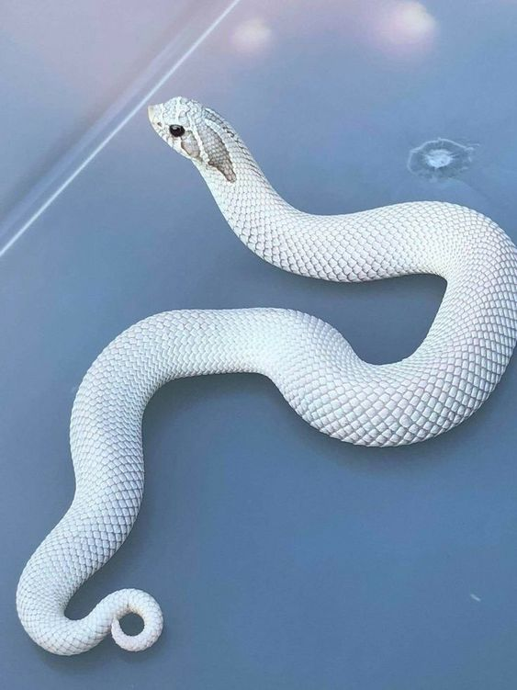
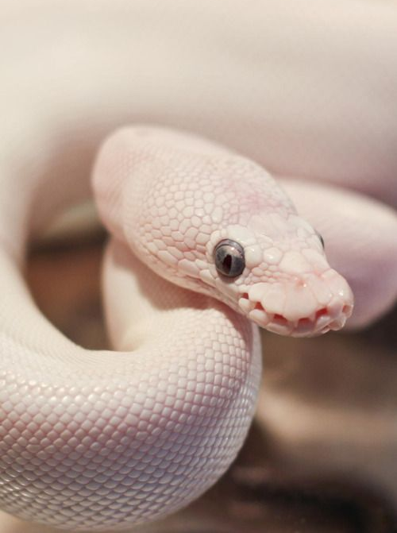
Research in form
The snake is the shape, or medium of communication, that I finally settled on for the piece.

Slide 10
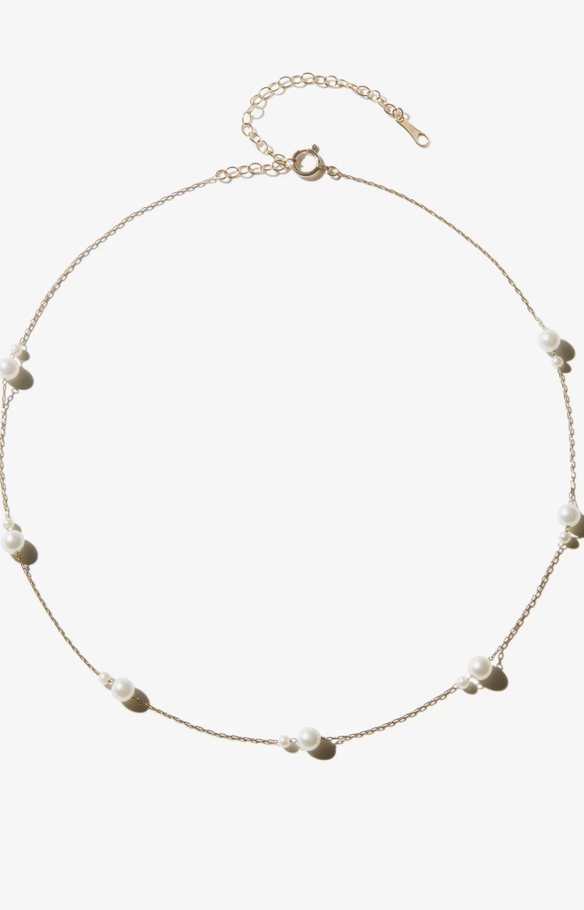
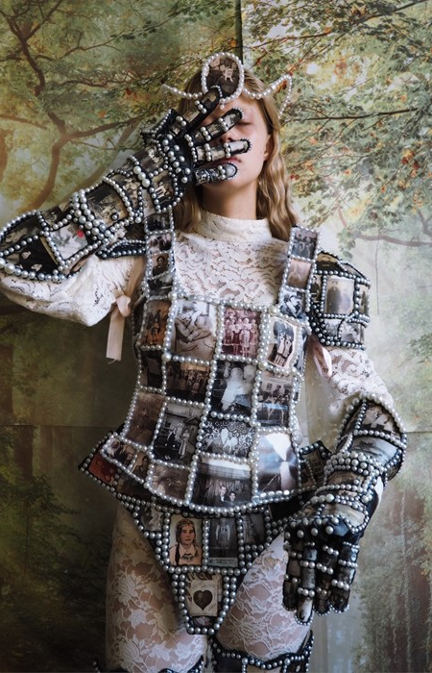
Material reference- relatively traditional and relatively avant-garde
Polina Osipova： Polina Osipova, who is more of an avant-garde artist, has instead incorporated several ethnic features.
Mizuki Goltz：In her work, the pearls show fluidity and harmony.

Slide 11
Preliminary draft
Structure and space
The fluid and variable boundaries
A combination of snake and accessory

Slide 12
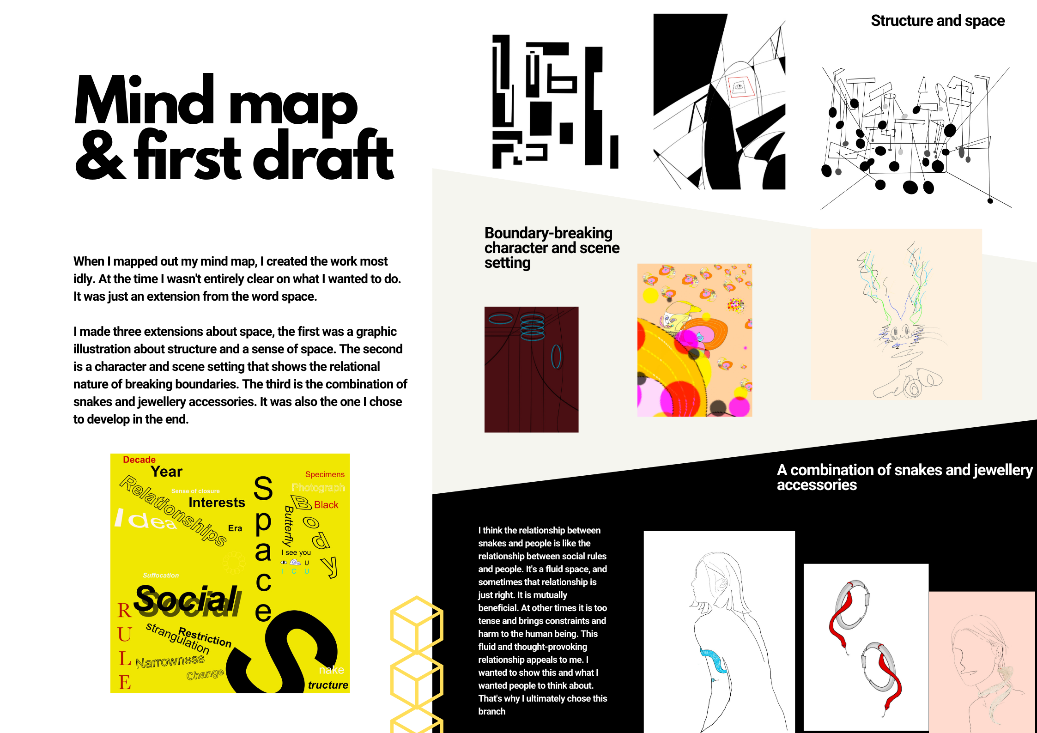

Slide 13
Final design
Name：The Touch of the Snake - Flowing Space

Slide 14
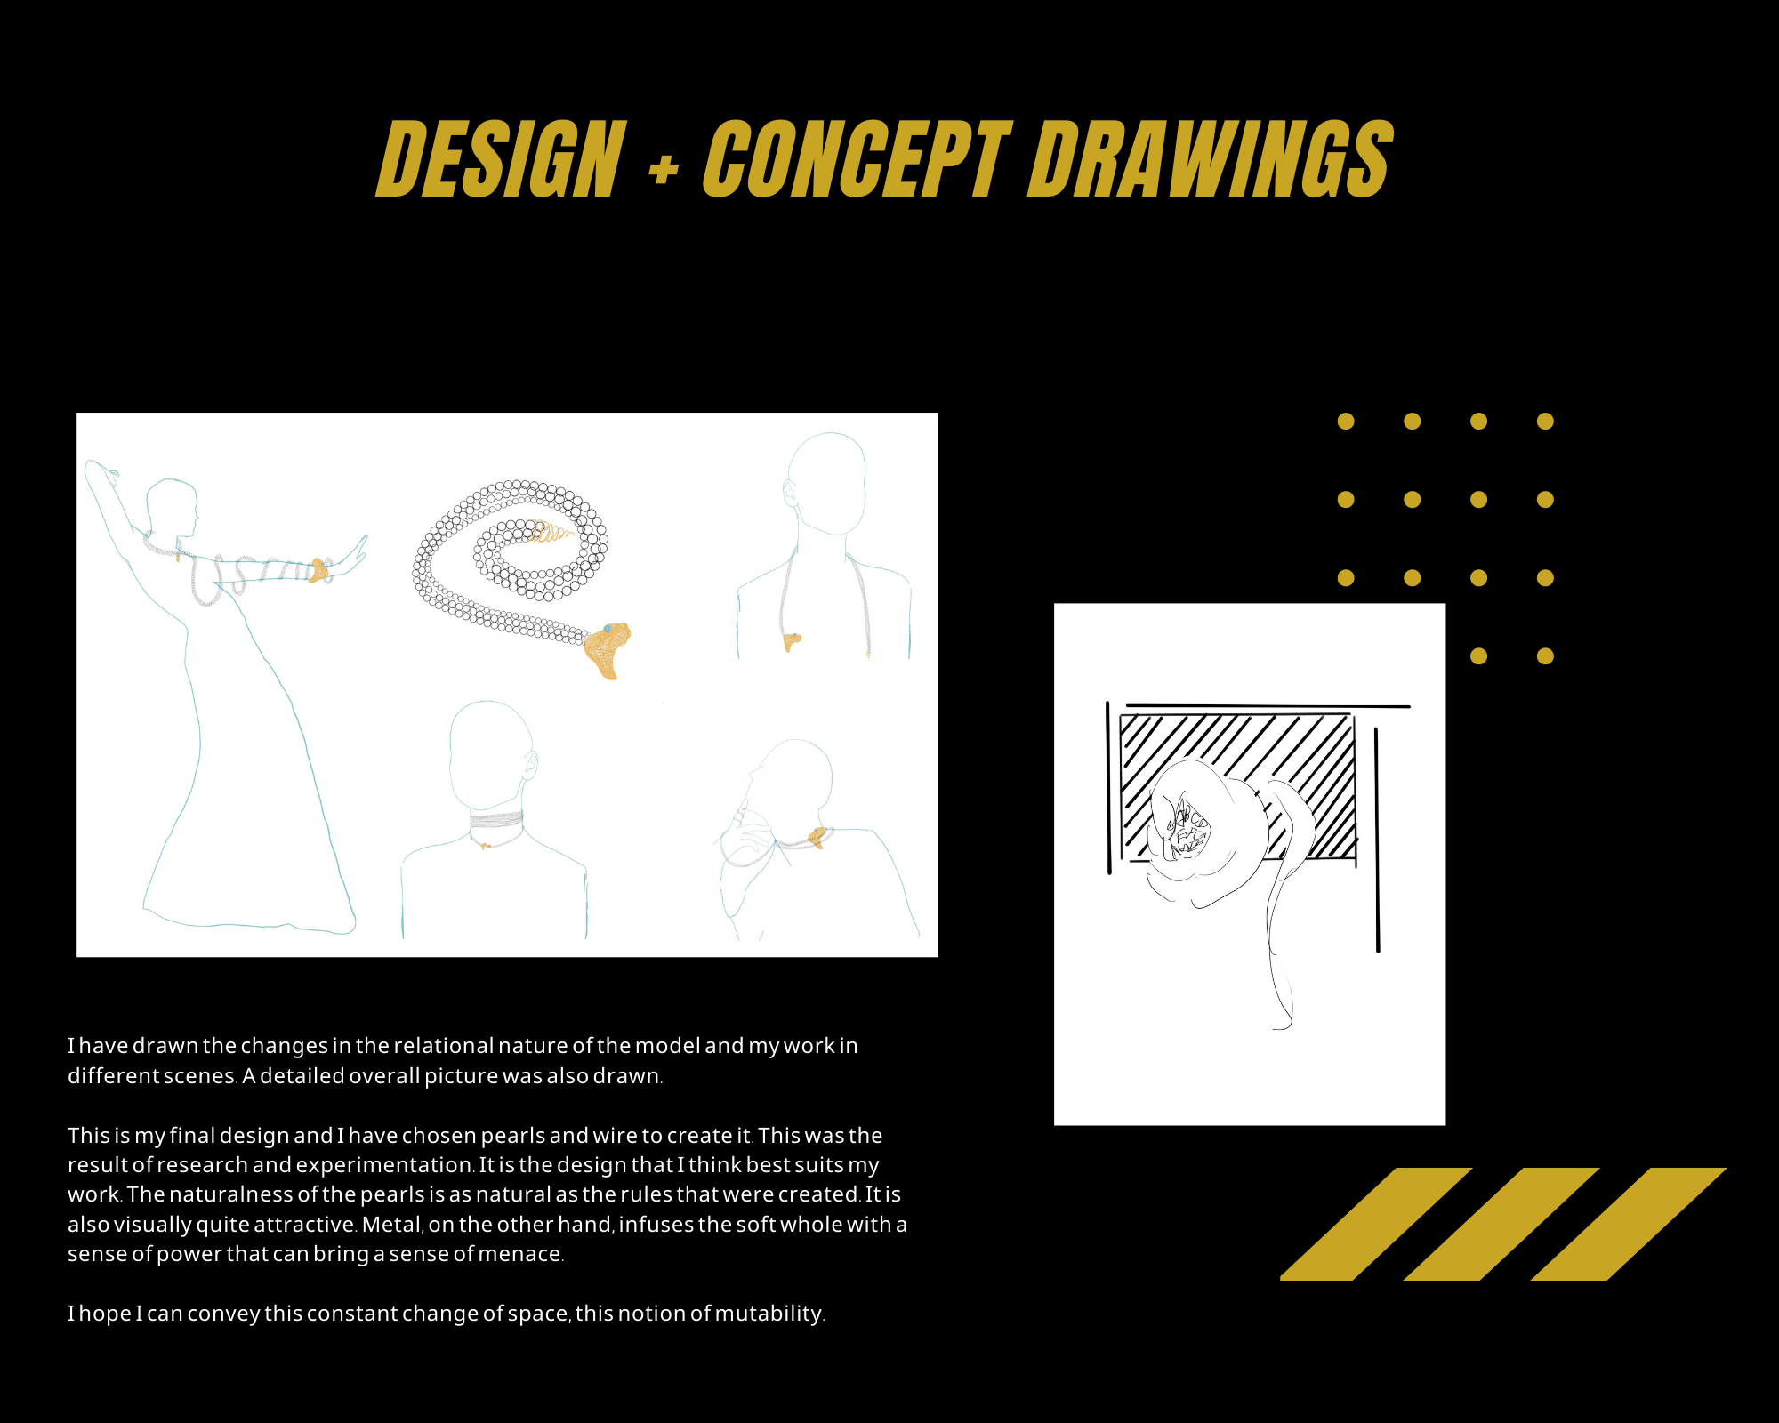

Slide 15
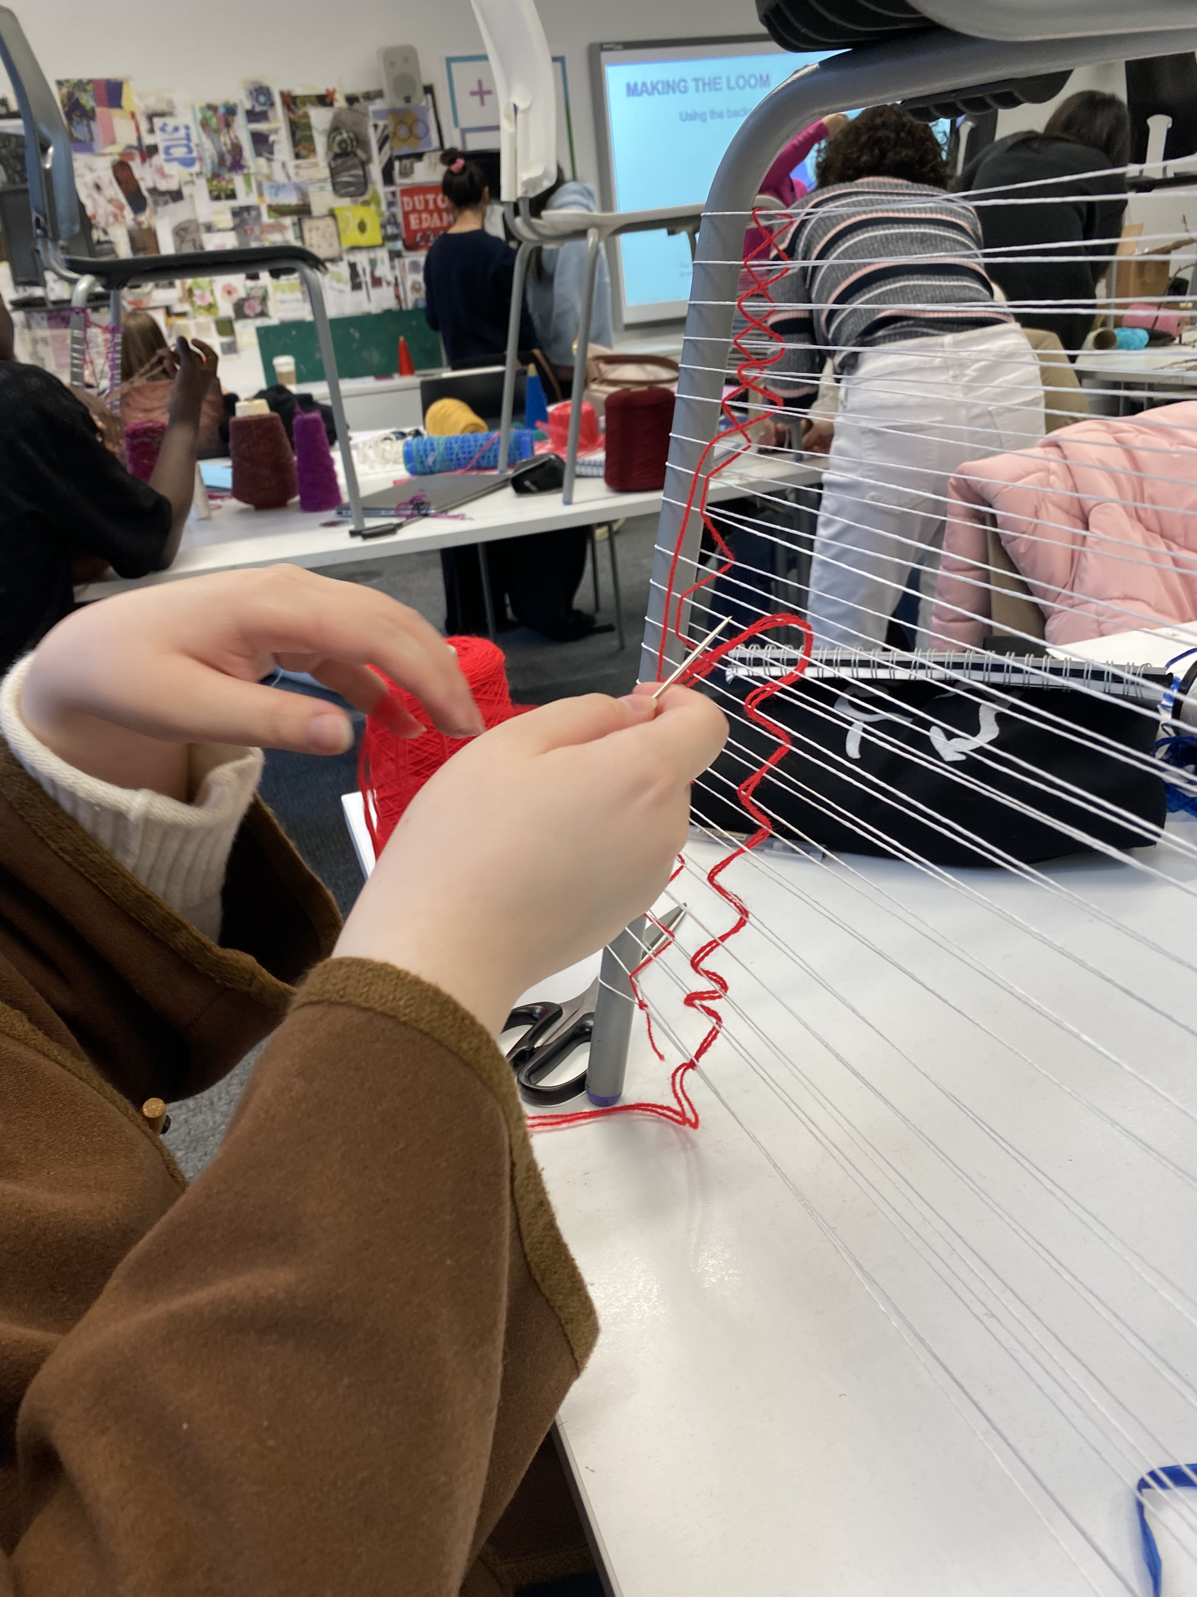
Experiment
Material experiment: clay/real pearls wire size
Modelling experiment： Weaving experiment Clay snake

Slide 16
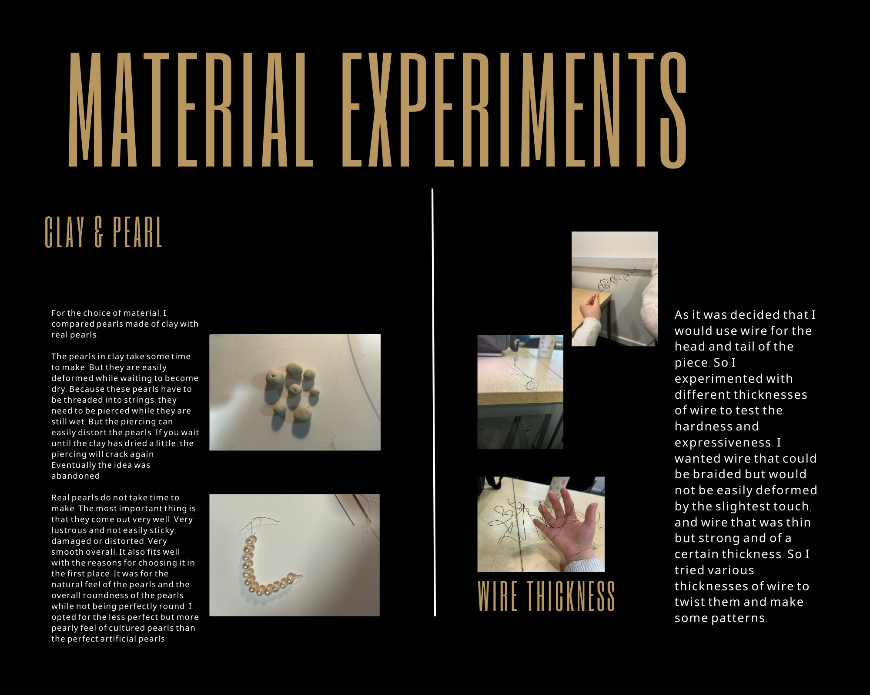

Slide 17
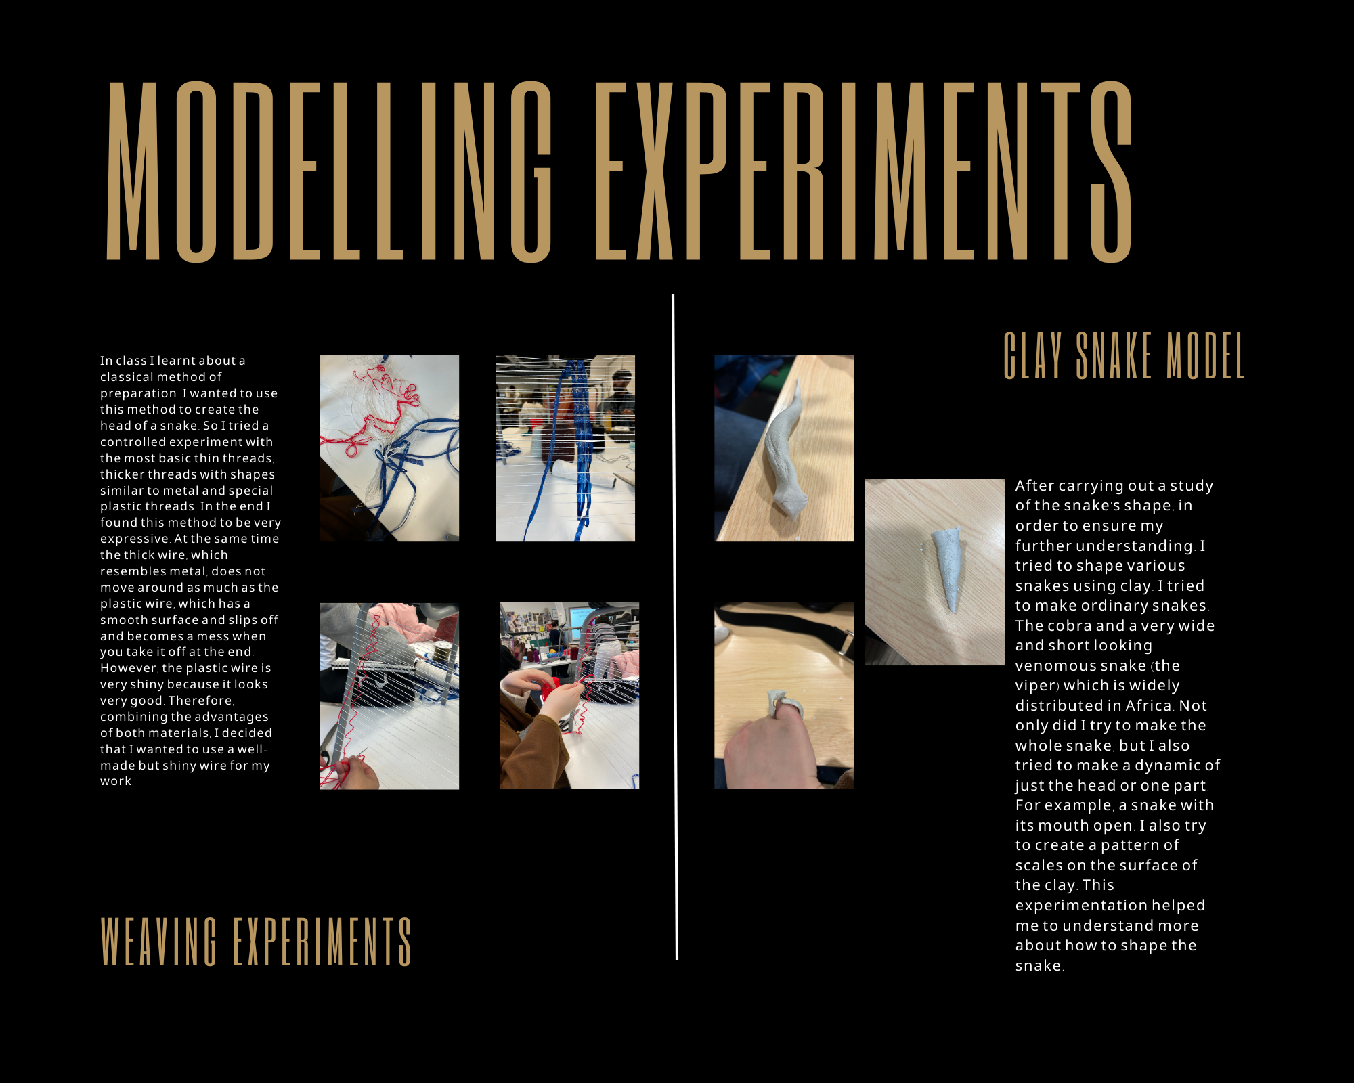

Slide 18
The process of making final work item

Slide 19
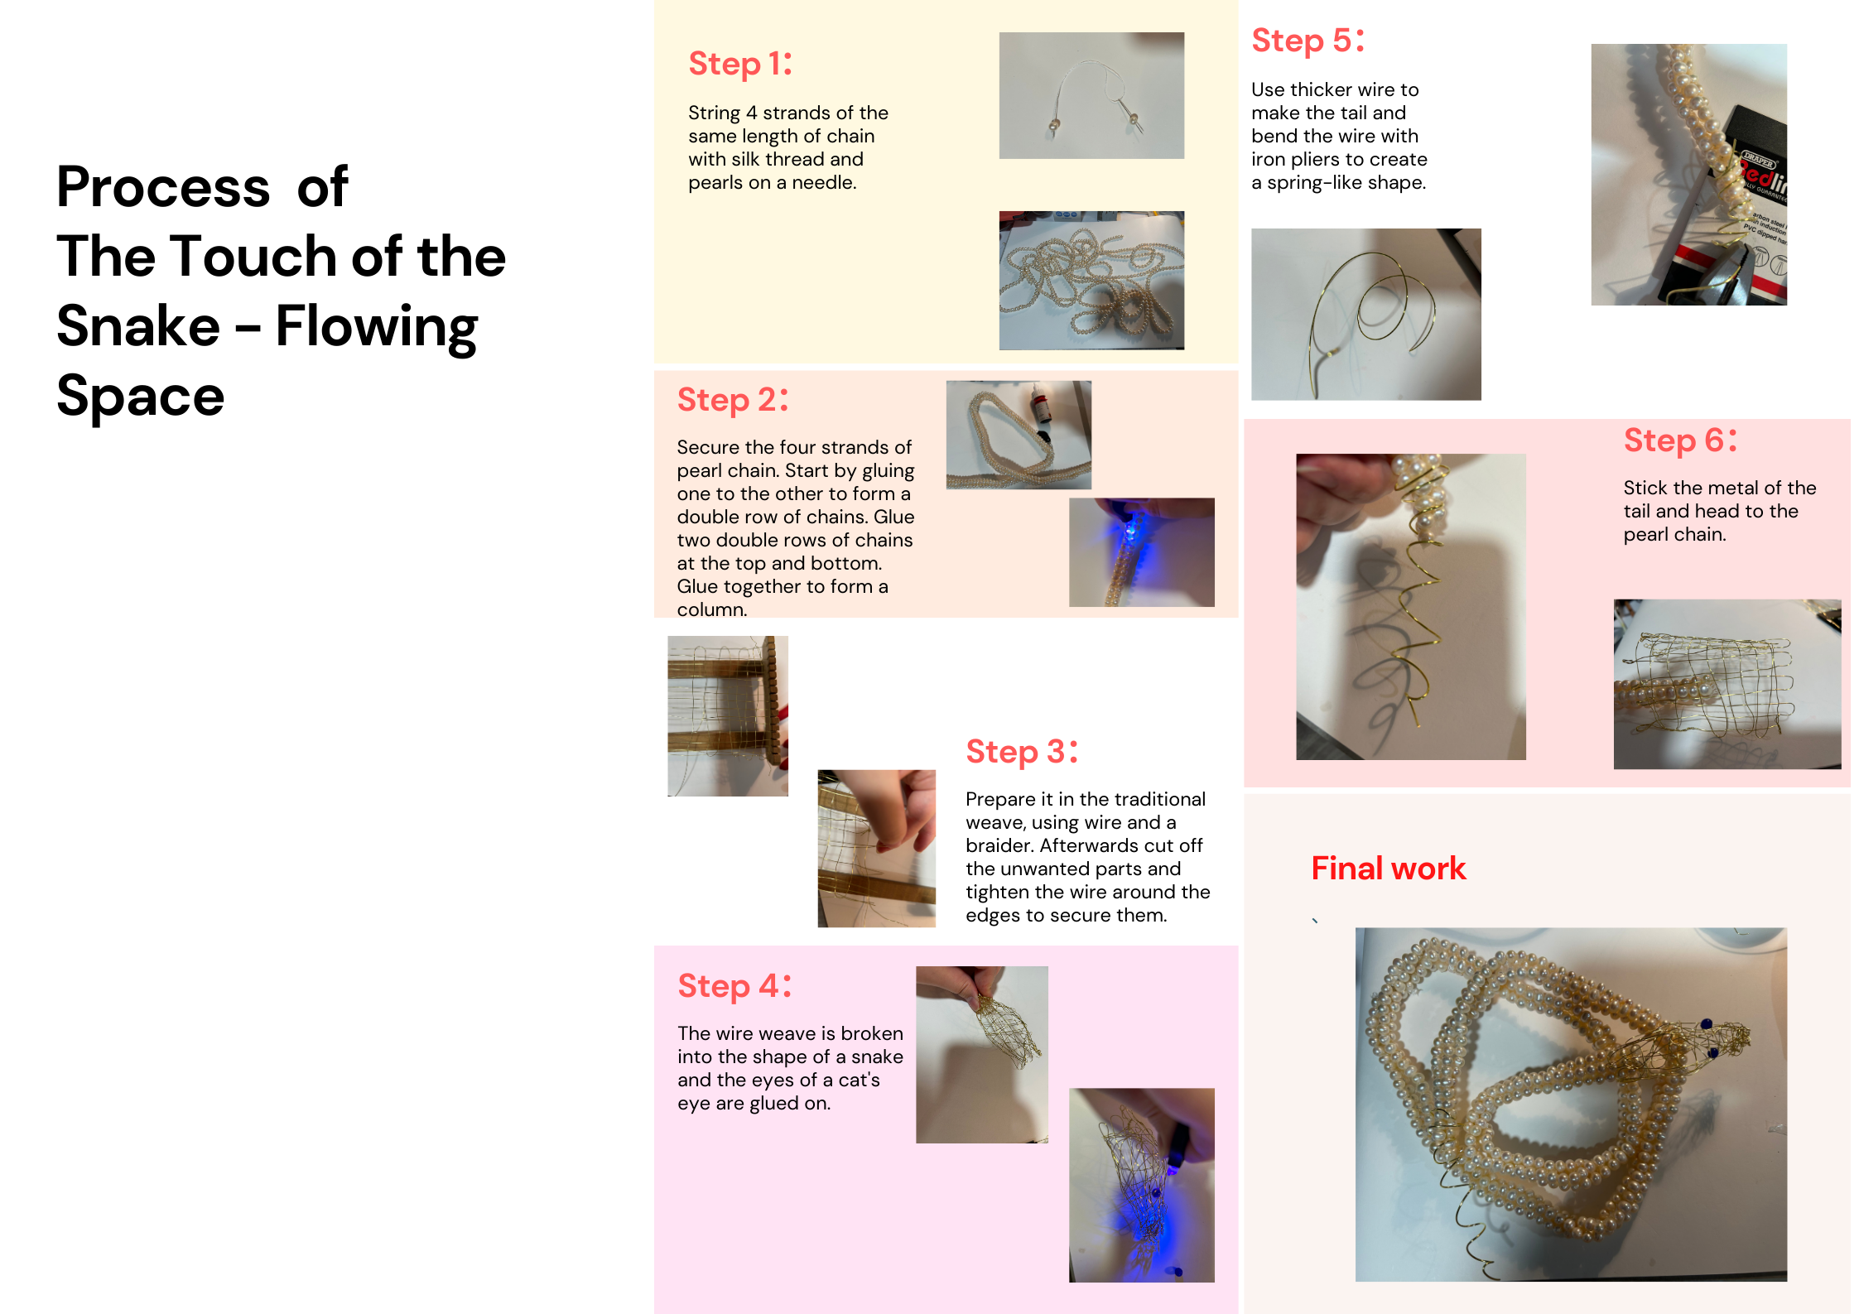

Slide 20
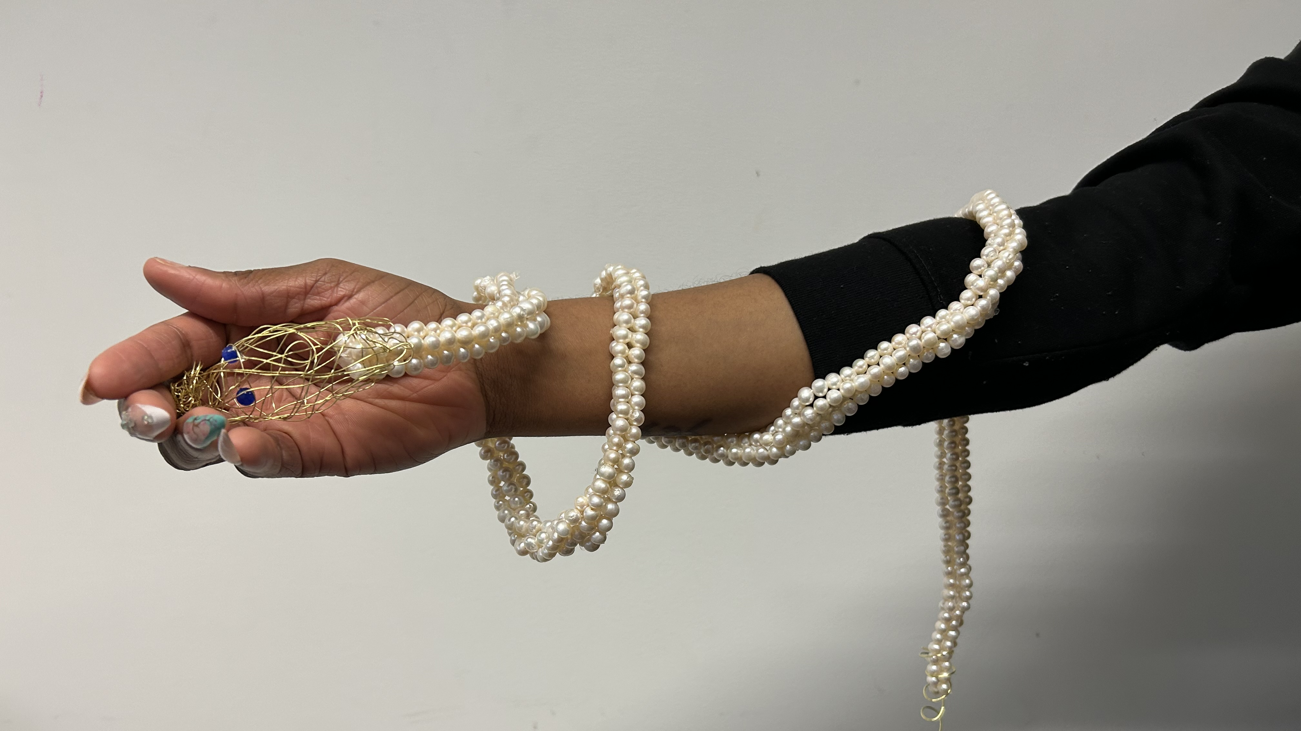
final work showing

Slide 21
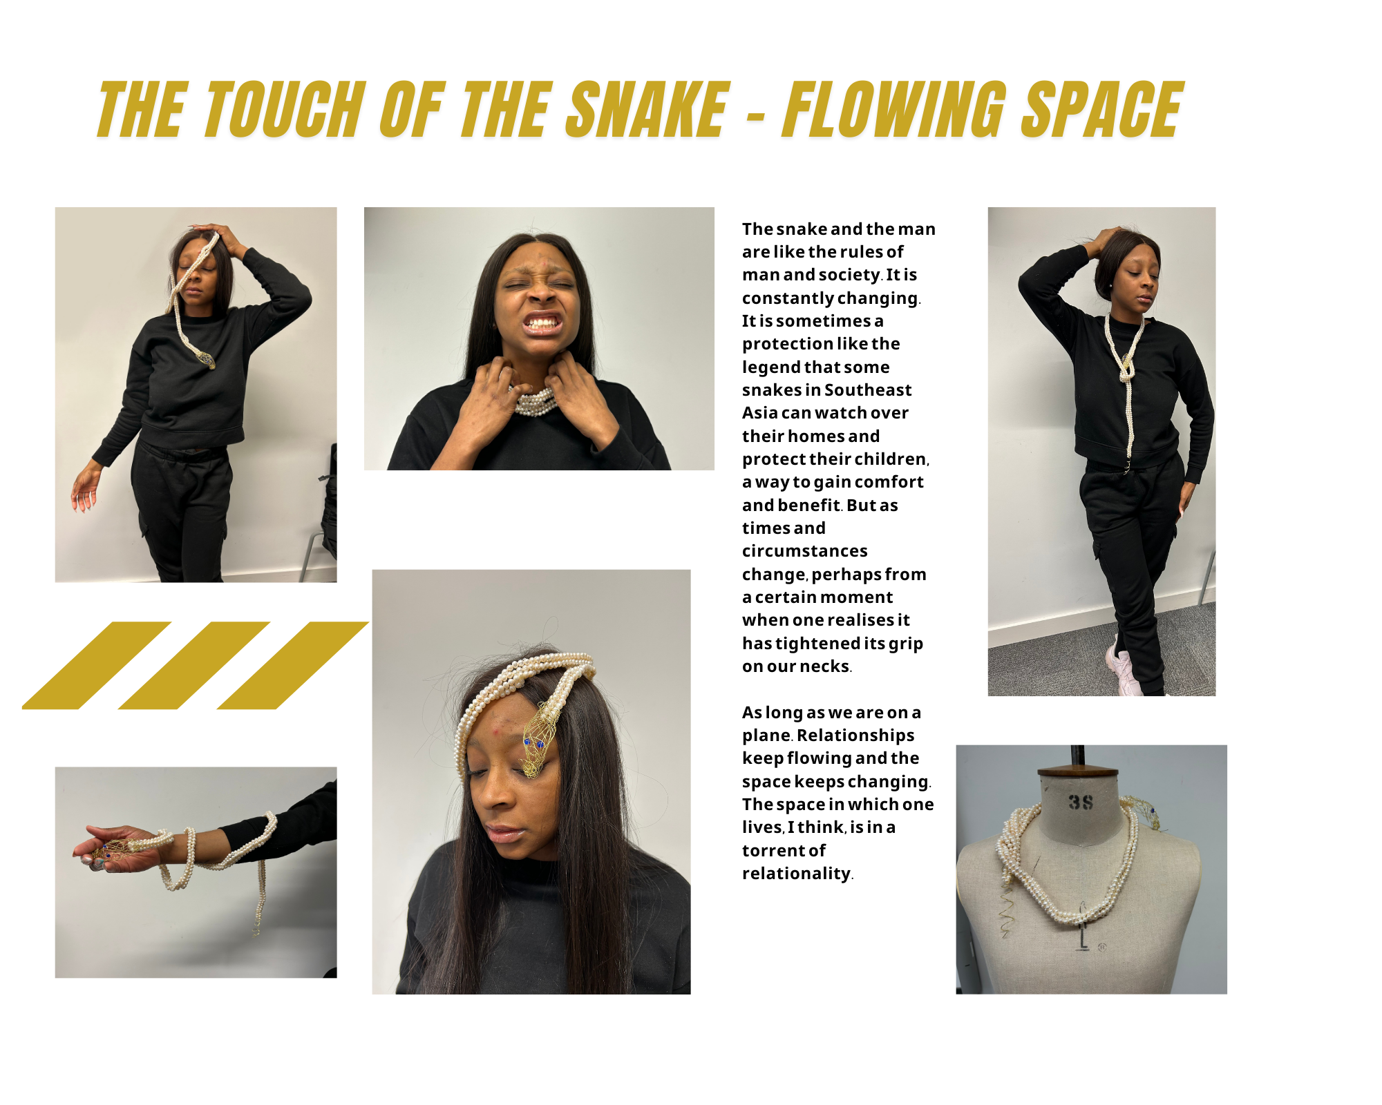

Slide 22
Finally？
Just creation is incomplete.

Slide 23
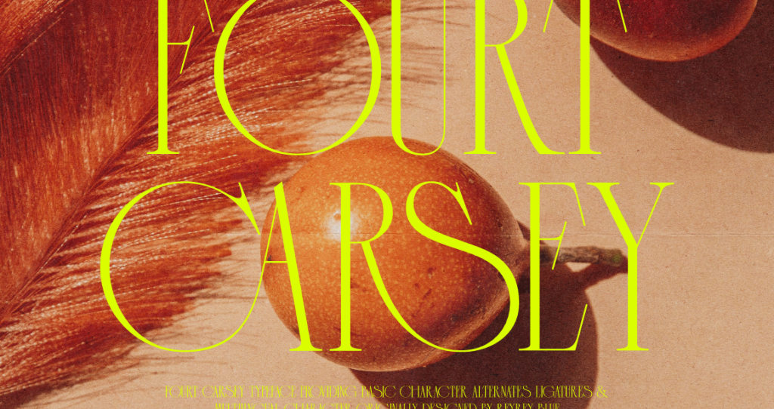
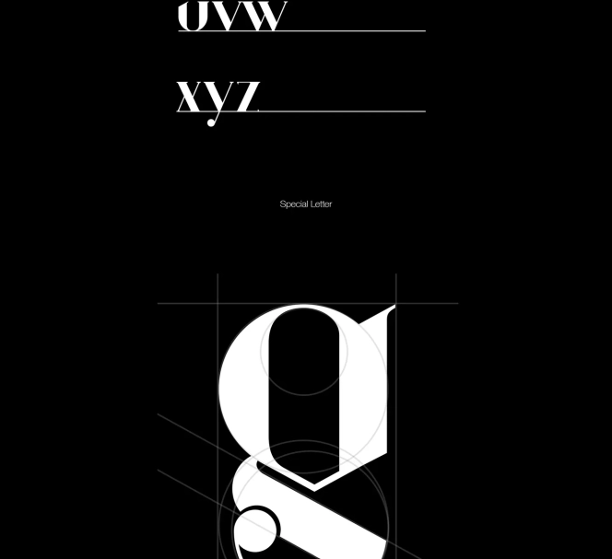
Exhibition
Promotional posters
design sheet production
PPT production

Slide 24
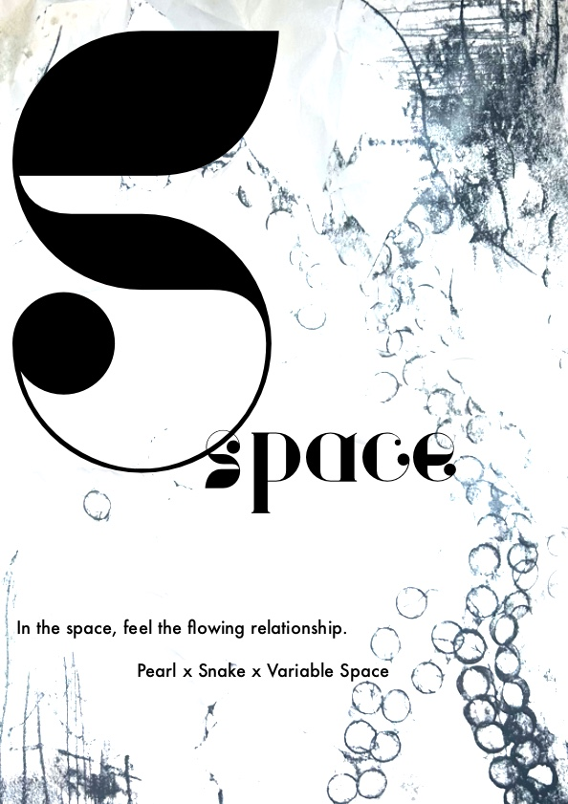
Poster

Slide 25
Finally

Slide 26
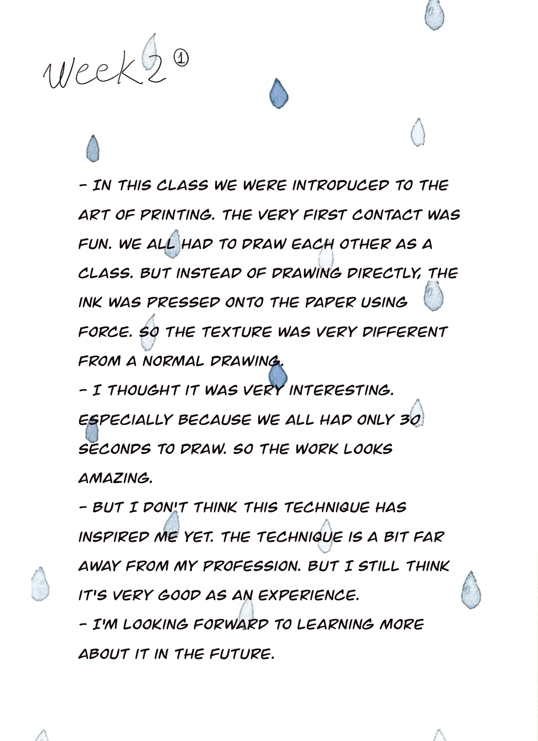
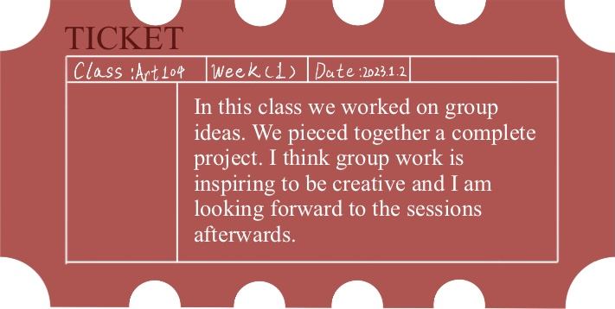
Reflection

Slide 27
Thank you for watching

Slide 28
Reference
About [www Document], n.d. . MIZUKI. URL https://mizukijewels.com/pages/about (accessed 2.23.23).
AnOther, 2023. Polina Osipova, the Artist and Designer Celebrating Her Chuvash Roots Iwww Document] . AnOther.
URI https://www.anothermag.com/fashion-beauty/14644/polina-osipova-chuvash-roots-gucci-florence-welch
(accessed 2.23.23).
Dazed, 2021. Polina Osipova is forging armour for the Chuvash warrior women of her past [www DocumentJ. Dazed.
URL https:/ /www.dazeddigital.com/art-photography/article/54629/1/polina-osipova-russian-artist-chuvash-gucci-
russia-traditional-folklore-craft (accessed 2.23.23).
Nast, C., 2022. Polina Osipova Is Putting Chuvash Culture On the Map In Russia-and Beyond [www Document].
Vogue. URL https://www.vogue.com/ article/polina-osipova-is-putting-chuvash-culture-on-the-map-in-russia-and-
beyond (accessed 2.23.23).

Slide 29
Nast, C., 2018.5 jewelry designers reinventing pearls Iwww DocumentJ. Vogue France. URL
https://www.vogue.fr/jewelry/profile/ story/5-jewellery-designers-reinventing-pearls/1779 (accessed 2.23.23).
Nast, C., 2022. Polina Osipova Is Putting Chuvash Culture On the Map In Russia-and Beyond [www Document].
Vogue. URL https://www.vogue.com/ article/polina-osipova-is-putting-chuvash-culture-on-the-map-in-russia-and-
beyond (accessed 2.23.23).
What Do Pearls Symbolize? The Meaning and History of Pearls Iwww Document], n.d. . Sterling Forever. URL
https:/ /www.sterlingforever.com/blogs/blog/what-do-pearls-symbolize-the-meaning-and-history-of-pearls
accessed 2.23.23).

Slide 30
Ebert, G., 2020. Fundreds of Photos of the New York Sky Are Pinned to a Massive, Spherical Sculpture by Sarah Sze
[WwW Document]. Colossal. URL https://www.thisiscolossal.com/2020/06/ sarah-sze-shorter-than-the-day/
(accessed 2.24.23).
Sarah Sze [Www Document], n.d. . Victoria Miro. URL https:/ /www.victoria-miro.com/artists/ 33-sarah-sze/ (accessed
2.24.23).
Sarah Sze [Www Document], n.d. . Victoria Miro. URL https:/ /www.victoria-miro.com/artists/ 33-sarah-sze/ (accessed
2.24.23).
Sarah Sze, Night into Day [www DocumentJ, n.d. . Fondation Cartier pour I'art contemporain. URL
https://www.fondationcartier.com/en/exhibitions/sarah-sze-1 (accessed 2.24.23).

Slide 31
Williamson, B., n.d. Sarah Sze IWww Document]. URL https://www.studiointernational.com/index.php/sarah-sze-
exhibition-review-victoria-miro-london (accessed 2.24.23).
A small, simple and smart family hallway [WWW Document], n.d. URL
https://www.ikea.com/gb/en/rooms/hallway/how-to/a-minimalist-family-hallway-pub3e1c27co (accessed
3.24.23).
Simeon Shomov “Labyrinth‘, ring - ilver 925’, 24k gold plated, 700 degrees glass enamel [WWW Document], n.d. URL https://putti.lv/simeon-shomov-labyrinth-ring-ilver-925%2%80%b2-24k-gold-plated-7oo-degrees-glass-enamel/(accessed 3.24.23).
Painting | History, Artists, Elements, Techniques, Types, & Facts | Britannica [WWW Document], n.d. URL
https://www.britannica.com/art/painting (accessed 3.24.23).
Tate, n.d. Constructivism [WWW Document]. Tate. URL https://www.tate.org.uk/art/art-terms/c/constructivism (accessed 3.24.23).

