Slide 1
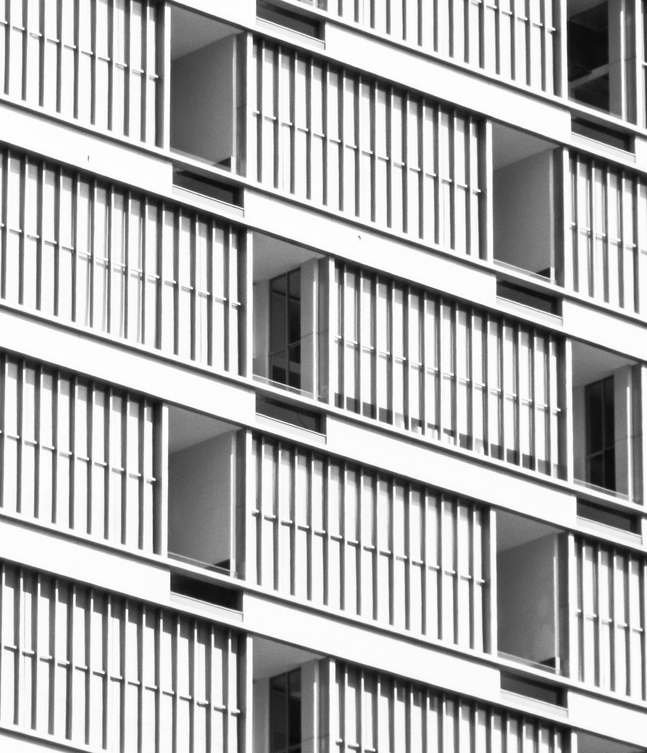
Constructivism
A spiritual revolution.
Viola

Slide 2
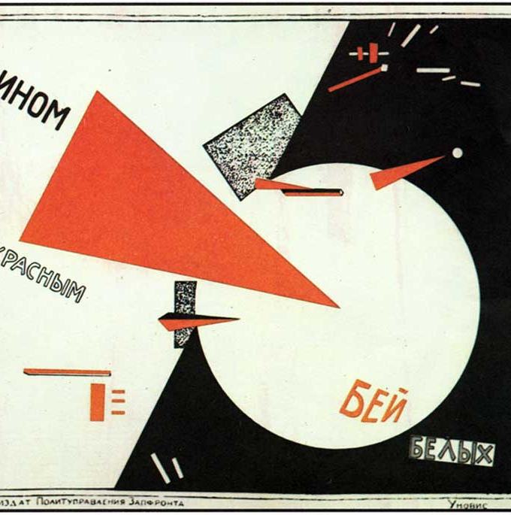
Characterises of this art movement
Structuralism was a pioneering art that became popular in the Soviet Union in the early twentieth century.
Structuralism differs from the various Classicalisms that were popular in the past in that they do not serve a designated person or class of people. Rather, they served the masses and sought to awaken the spirit of the people. To guide the minds of the people.
Works that serve the masses must be of a practical and communal nature. The identity of the artist has therefore changed. According to Magazine artland 'In Constructivism, the role of the artist was re-imagined - the artist became an engineer wielding tools, instead of a painter holding a brush."
Under the idea of Constructivism, art existed to help people communicate ideas. It was more like a tool or a medium.

Slide 3
The origins of Constructivism
According to the artland words. Constructivism is a theory of art and architecture that originated in Russia in early 1913 by Vladimir Tatlin. It was an opposition to the idea of autonomy through the construction of art. The movement supported the practice of art as a social goal.

Slide 4
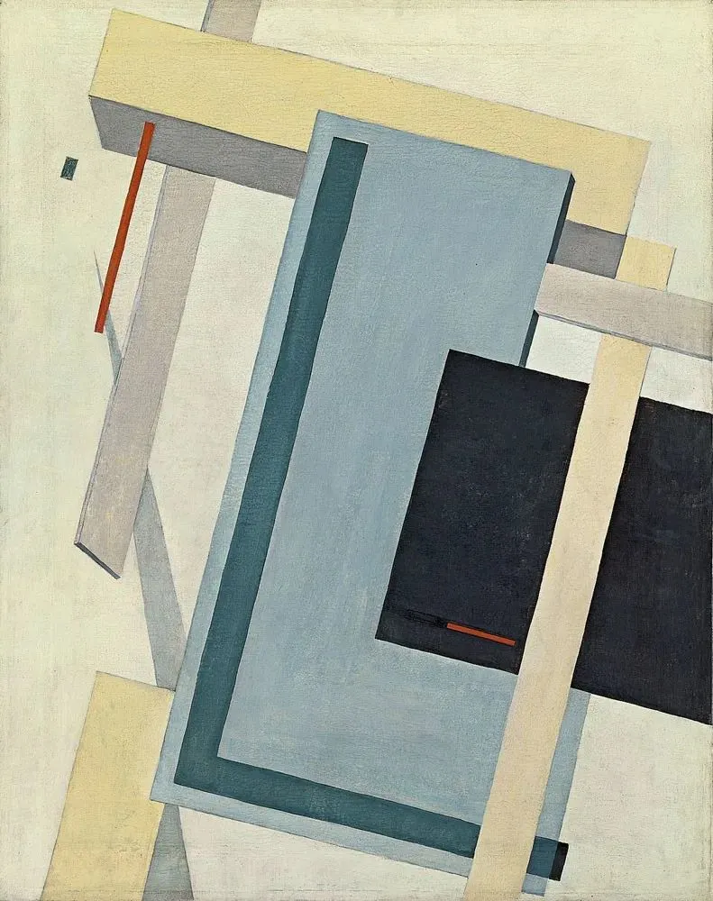
History
The emergence and development of structuralism coincided with the aftermath of the Russian Revolution. Ideologically the artists received the influence of Marxism. At the same time, because of the revolution, the country introduced a new order of industrialisation. The change in the general environment and the many influences that made up structuralism.

Slide 5
Visual representation
According to the Tate. The material formation of the object is to be substituted for its aesthetic combination. The object is to be treated as a whole and thus will be of no discernible ‘style’ but simply a product of an industrial order like a car, an airplane, and such like. Constructivism is a purely technical mastery and organization of materials.
Structuralism absorbed cubist spatial structures, etc. Thus both space and structure are studied in depth. Often there is a certain industrial feel to it.

Slide 6
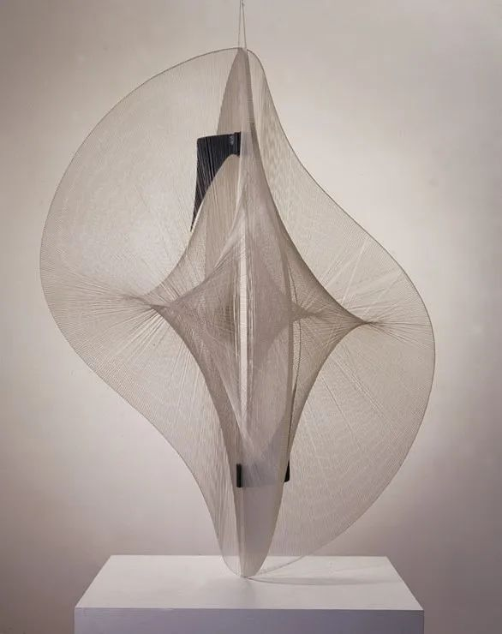
Impact
Structuralist artworks are often involved in life. Examples include sculpture, architecture, book design, typography, furniture, theatre sets and so on. Structuralism therefore had an influence on industrialised art, such as furniture and instruments.
At the same time, Structuralism included the collage techniques of Cubism, the dismantling and reorganisation of objects, and their in-depth study of materials, space and structure, which has given Structuralism a strong influence on modern sculpture and architecture.

Slide 7
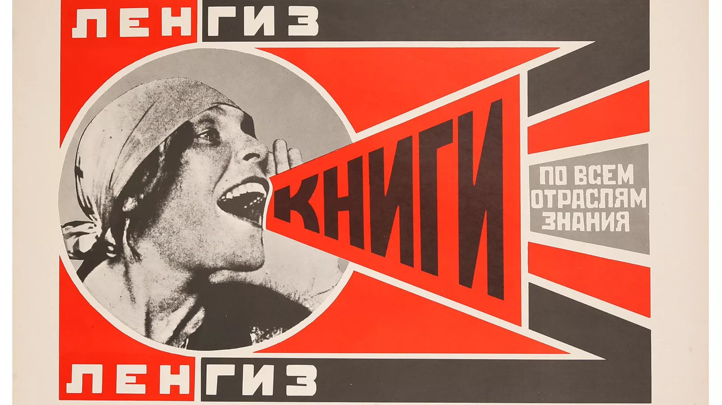
Constructivism’s artists

Slide 8
Vladimir Tatlin
Vladimir Tatlin, in full Vladimir Yevgrafovich Tatlin, (born December 16 [December 28, New Style], 1885, Kharkov, Russian Empire [now in Ukraine]—died May 31, 1953, Moscow, Russia, U.S.S.R.), Ukrainian painter, sculptor, and architect remembered for his visionary “Monument to the Third International” in Moscow, 1920.

Slide 9
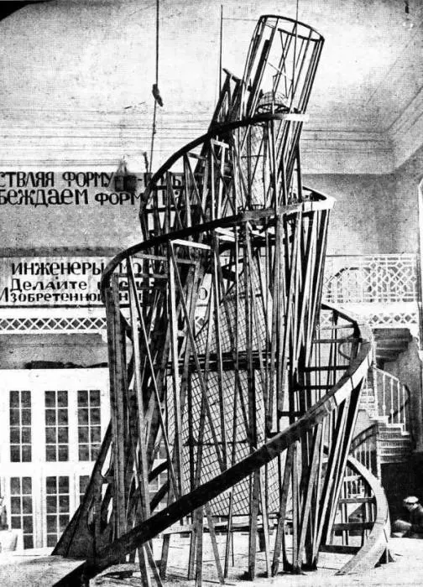
The famous work- Vladimir Tatlin's Monument to the Third International
Vladimir Tatlin's Monument to the Third International is a tall spiral tower made of glass and iron. It represents structuralism and the spiritual aspirations of the Soviets of the era.
The work is a multidisciplinary mix of painting, architecture and sculpture. It represents a modern spirit and a revolutionary ethos.

Slide 10
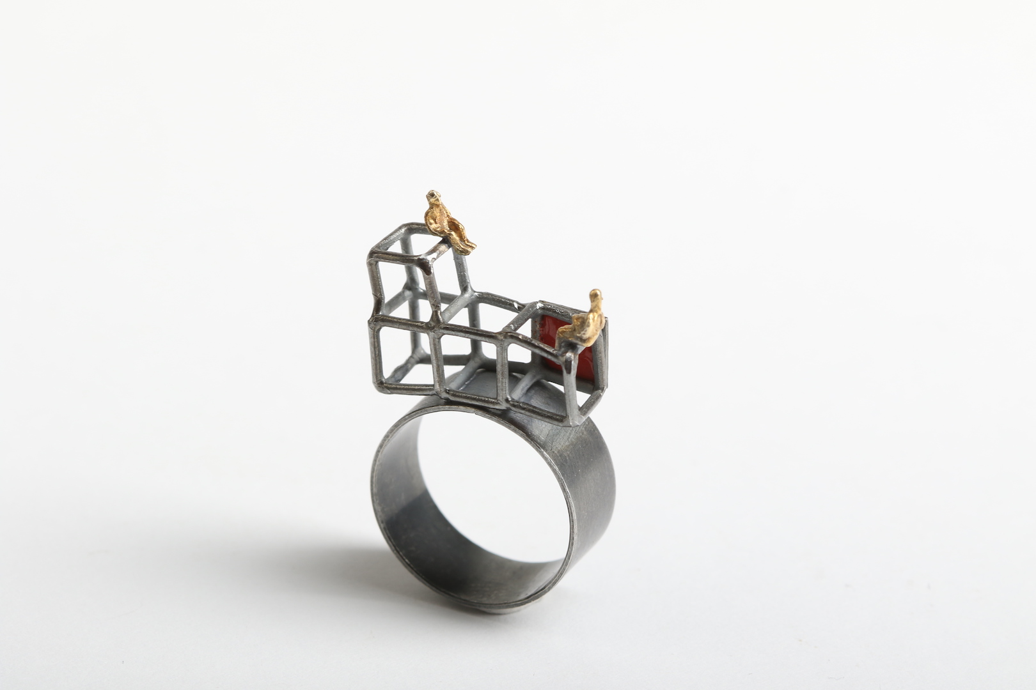
Simeon Shomov- Narrative silver jewellery
This is a Bulgarian jewellery artist. He uses silver and a small amount of gold to produce a structured work of art with clear contours.
This work illustrates a story and also illustrates different spaces through the staggering of the results. But with the influence of structuralism, it is not a mere work of art. It is a piece of jewellery that can be worn and used.

Slide 11
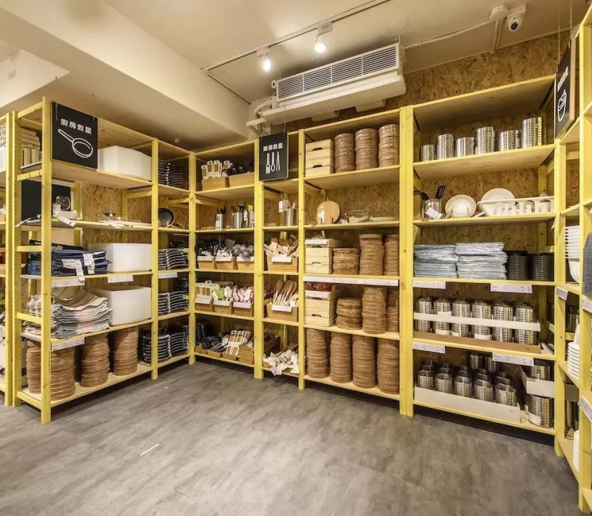

Ikea
“Keeping a small hall calm and tidy when you have kids can be a big challenge. Here you can find lots of ideas to help you organise a family-friendly, functional space and still stay true to your minimalist soul.”

Slide 12
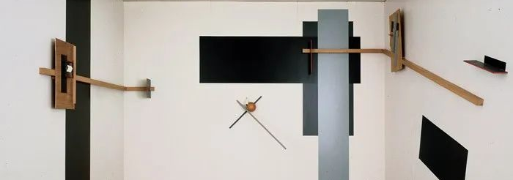
Finally- for myself
I think structuralism is one of the founding ideas of modern art and has had a strong influence on most modern art.
It has undergone a complete revolution in materials and ideas as well as audiences and is an idea as well as an artistic style that responds to the changing systems of the times.

Slide 13
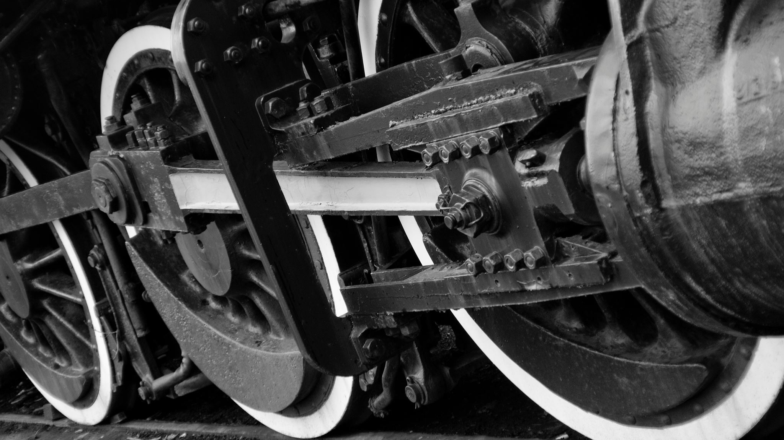
Tank you for watching

Slide 14
Reference
A small, simple and smart family hallway [WWW Document], n.d. URL
https://www.ikea.com/gb/en/rooms/hallway/how-to/a-minimalist-family-hallway-pub3e1c27co (accessed
3.24.23).
Simeon Shomov “Labyrinth‘, ring - ilver 925’, 24k gold plated, 700 degrees glass enamel [WWW Document], n.d. URL https://putti.lv/simeon-shomov-labyrinth-ring-ilver-925%2%80%b2-24k-gold-plated-7oo-degrees-glass-enamel/(accessed 3.24.23).
Painting | History, Artists, Elements, Techniques, Types, & Facts | Britannica [WWW Document], n.d. URL
https://www.britannica.com/art/painting (accessed 3.24.23).
Tate, n.d. Constructivism [WWW Document]. Tate. URL https://www.tate.org.uk/art/art-terms/c/constructivism (accessed 3.24.23).
Williamson, B., n.d. Sarah Sze [WWW Document]. URL https: //www.studiointernational.com/index.php/sarah-sze-exhibition-review-victoria-miro-london (accessed 2.24.23).

